Slide 1

Sentiment Analysis
Bhargav Somepalli
OGTIP

Slide 2
Project Description
Given Data:
Real data of tweets collected during the outbreak of the Covid-19 disease.
Objective:
Conduct sentiment analysis on the collected tweets to understand public perception and sentiment towards the COVID-19 pandemic.
Significance:
The perception of the disease significantly impacted psychological care.
Negative sentiments expressed in tweets reflected the psychological health challenges faced by individuals.
Goal:
Identify which parts of the world were most affected by mental trauma as indicated by negative sentiments in tweets.
Provide real-time analysis of the situation to facilitate prompt support to regions most in need, anticipating future outbreaks or crises.

Slide 3
Data Description
Scope:
Collection of 41157 tweets from Twitter during the critical initial months of the Covid-19 pandemic, capturing global public sentiment.
Period:
Tweets span from 03/16/2020 to 04/14/2020, offering insights into evolving sentiments as the situation developed.
Sentiment Classification:
Tweets are categorized into sentiments (Positive, Negative, Neutral), facilitating an analysis of public mood.
Geographical Insights:
Includes location data for geographical sentiment analysis, highlighting regions with pronounced negative sentiments.
Objective:
To leverage sentiment analysis for understanding public perception, identifying regions under mental distress, and aiding future outbreak preparedness.

Slide 4
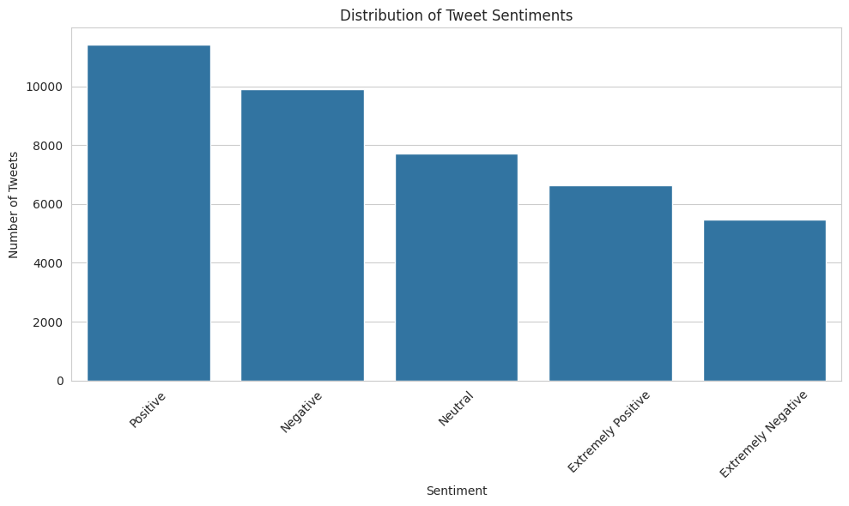
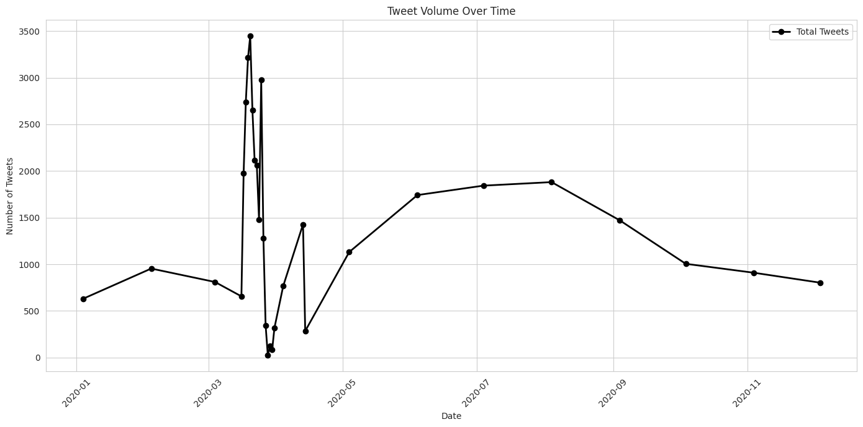
Exploratory Data Analysis
Date Range: April 1-12, 2020, capturing the early Covid-19 global impact.
Tweet Volume: Sharp increase, peaking at 1,977 tweets on April 17, indicating rising public engagement.
Sentiment Dynamics: Daily sentiment varied, with Negative tweets (156) leading on April 1st and Positive tweets (558) dominating by April 8th, mirroring public reaction to unfolding events.

Slide 5
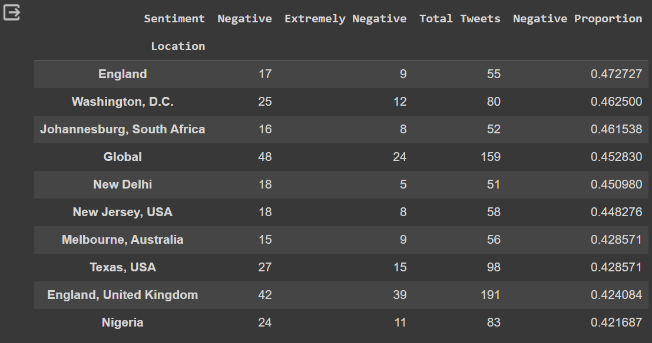
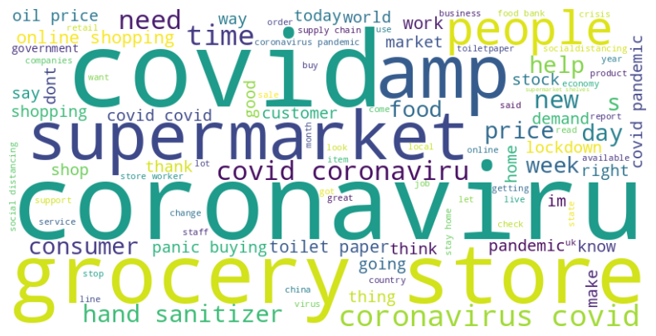
EDA Continued
Sentiment Mix: Data shows varied sentiments, tilting slightly positive, indicative of diverse public emotions.
Regional Voice: High tweet activity in London, the US, and NY, indicating significant local engagement.
Sentiment Over Time: Tweet volume surged, peaking mid-April, mirroring the public's response to changing pandemic conditions.
Thematic Insights: Analysis reveals key pandemic concerns around health, society, economy, and community efforts.

Slide 6
Data Preprocessing
Normalization: Converted all tweets to lowercase to ensure uniformity.
Cleaning:
Removed URLs and handles to focus on the relevant text.
Stripped away hashtags and punctuation, which could skew text analysis.
Tokenization: Broke down tweets into individual words for detailed processing.
Stopword Removal: Eliminated common English stopwords to highlight meaningful words.
Lemmatization: Applied lemmatization to reduce words to their base or dictionary form, facilitating a more accurate analysis.
Feature Extraction: Utilized TF-IDF vectorization on up to 5000 features to quantify and categorize text data for machine learning.
Data Split: Segregated the dataset into 80% training and 20% testing sets for model evaluation.

Slide 7
Model Selection
Logistic Regression (LR):
A baseline model for benchmarking performance due to its simplicity and interpretability.
Useful for understanding feature importance in sentiment classification.
Random Forest (RF):
An ensemble method that can capture non-linear relationships without extensive hyperparameter tuning.
Robust to overfitting and effective for feature-rich data like TF-IDF vectors.
LSTM (Long Short-Term Memory):
Capable of capturing sequential dependencies in text data, crucial for understanding context in sentiment analysis.
A deep learning approach to model the intricacies of language patterns.
Bidirectional LSTM:
Extends LSTM capabilities by processing data in both forward and reverse directions, enhancing context comprehension.
Aims to improve upon LSTM by leveraging the full context of a sentence.

Slide 8
Results
Model | Accuracy(%)
Logistic Regression | 57.19
Random Forest | 52.78
LSTM | 71.82
Bidirectional LSTM | 65.94
Logistic Regression: Achieved an accuracy of 57.19%, setting a benchmark for model performance.
Random Forest: Showed an accuracy of 52.78%, indicating room for improvement with ensemble methods.
LSTM Model: Outperformed traditional ML models with an accuracy of 71.82%, reflecting the strength of sequence modeling in NLP.
Bidirectional LSTM: Registered an accuracy of 65.94%, showcasing the potential of context-aware learning in both directions of text data.

Slide 9
Conclusion
The sentiment analysis revealed a diverse range of emotions, with a slight overall tilt towards positivity, suggesting resilience amidst the crisis.
Geographical sentiment distribution indicated that tweets from London, the United States, and New York, NY were particularly prominent, pointing towards higher engagement or impact in these areas.
Temporal analysis showed an increase in tweet volume during the early phase of the pandemic, with sentiment fluctuations likely reflecting public response to new information and changing circumstances.
Northern Hemisphere regions appeared more vocal on Twitter, which may correlate with the spread of Covid-19 and the concentration of English-speaking Twitter users.

Slide 10
Future works
Deeper Linguistic Analysis: Implementing advanced NLP techniques to understand the context and nuances better, such as irony and sarcasm, which are prevalent in social media.
Sentiment Tracking Over Time: Extending the analysis to cover subsequent phases of the pandemic could offer insights into long-term sentiment trends.
Cross-Referencing with Events: Integrating global events, policy announcements, and news headlines to correlate sentiment shifts with specific causes.
Comparative Regional Studies: A detailed study to understand why certain regions showed more activity could be insightful. Factors could include the progression of the pandemic, population density, internet penetration, or the presence of major cities that are active on social media.

Slide 11

Thank You

